Slide 1
CSDS 451: Designing High Performant Systems for AI
Lecture 12
10/2/2025
Sanmukh Kuppannagari
sanmukh.kuppannagari@case.edu
https://sanmukh.research.st/
Case Western Reserve University

Slide 2
Outline
Introduction to AMD’s GPU Programming Stack
AMD GPU Hardware Model
AMD Programming Model
Implementation Basics

Slide 3
Announcements
WA 2 due by Friday
PA 1 will be out by Saturday Morning
Midterm next Thursday - 10/9
Will cover topics till the previous lecture

Slide 4
Midterm Logistics
60 minute exam, on paper
15~20 Fill in the blank/True-False questions
With space for explanation
1 point for answer
2 for explanation - wrong answer with a reasonable explanation will receive partial credits
2 big questions

Slide 5
Midterm Logistics
Open Notes
You can use slides
I suggest you create a cheat sheet: You won’t have enough time to search for concepts.
No questions during exam (Gets too distractive)
If a questions is ambiguous, write your assumption and solve
The assumption will be taken into consideration when grading
You should not need a calculator
You can use your phone if you do need it

Slide 6
Midterm Logistics
Exam may be lengthy (intentionally)
If you know the concepts well, you should be able to solve in time
Searching your notes or slides will incur additional time
Plan the questions you want to solve first accordingly
Suggestion: Get the big questions out of the way.
Don’t get stuck on a question. If you can’t solve go ahead and come back
If you don’t know an answer, write your explanation. We will consider that while grading

Slide 7
PA 1 Tips
Run the example code from canvas as early as possible, to make sure things are properly setup for you. If not, reach out to the Tas
Please review this document for best practices and this document for more information on how to schedule jobs
We have limited number of GPUs (6 for this course), so please do not hold them
Use the parameter --time=1:00:00 (1 hour, 0 minutes, 0 seconds) to set reasonable time limits. You should not be needing more than a few minutes of time to run your code
When you get disconnected from the terminal abruptly, the gpus still remain assigned to you until the time limit exceeds. So, it is even more important to correctly set the time limit
There will not be any extensions because you are unable to get GPU nodes closer to the deadline (which will happen), so start early and finish it as soon as you can

Slide 8

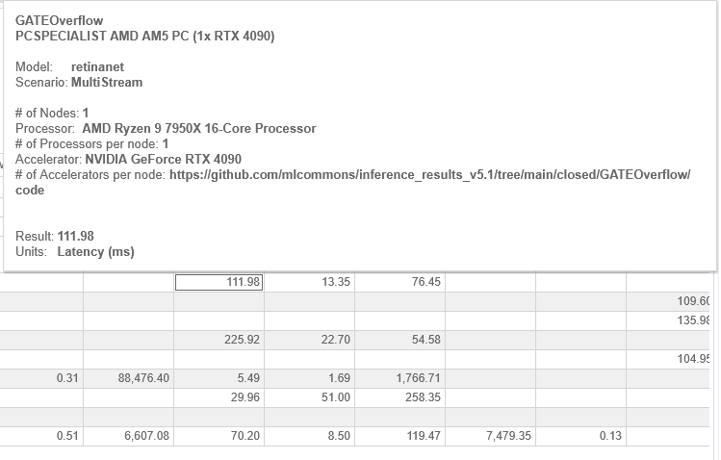
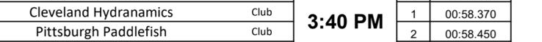
Study Hard for your Midterm!
https://mlcommons.org/benchmarks/inference-edge/
Won by 80 ms
Comparable to CNN inference times on a gaming GPU

Slide 9
Outline
Introduction to AMD’s GPU Programming Stack
AMD GPU Hardware Model
AMD Programming Model
Implementation Basics

Slide 10
Resources
ROCm Documentation - https://rocm.docs.amd.com/en/latest/
Presentation by AMD - https://www.exascaleproject.org/wp-content/uploads/2017/05/ORNL_HIP_webinar_20190606_final.pdf

Slide 11
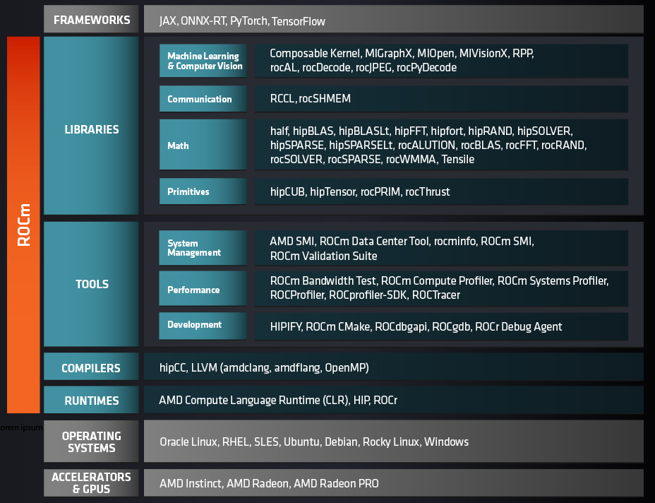
ROCm (Radeon Open Compute)
Open-source GPU computing platform by AMD, Designed for HPC, AI/ML, and scientific workloads.
It is developed as an alternative to CUDA and supports HIP (Heterogeneous Interface for Portability).
It includes a Compiler (LLVM-based), Runtime (HIP runtime, ROCr), Drivers & tools, Libraries (rocBLAS, MIOpen, RCCL, etc.)

Slide 12
HIP (Heterogeneous-compute Interface for Portability)
C++ runtime API and kernel language that allows developers to create portable applications that can run on AMD’s accelerators as well as CUDA devices.
Is open-source.
Provides an API for an application to leverage GPU acceleration for both AMD and CUDA devices.
Syntactically similar to CUDA. Most CUDA API calls can be converted in place: cuda -> hip
Supports a strong subset of CUDA runtime functionality.

Slide 13
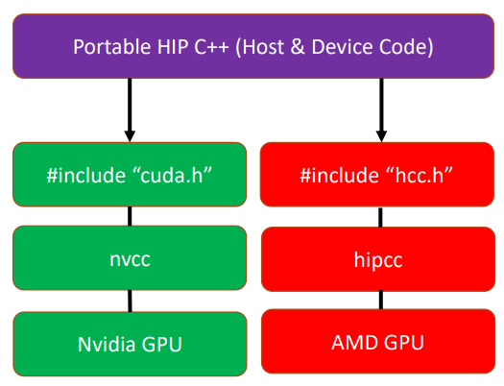
HIP - Portability & CUDA Interoperability
Similar syntax to CUDA
Many CUDA constructs map directly to HIP
Hipify tools
Utilities (hipify-clang, hipify-perl) to convert existing CUDA code to HIP automatically
Single source portability
A single HIP codebase can run on NVIDIA (via CUDA path) or AMD GPUs depending on compilation target

Slide 14
HIP - Architecture & Compilation Flow
HIP source is compiled by hipcc, which wraps Clang/LLVM or redirects to NVCC depending on target.
On AMD target: HIP → LLVM → AMDGPU backend → GPU machine code.
On NVIDIA target: HIP acts as a thin layer over CUDA, forwarding many calls to NVCC / CUDA runtime.
The model sits close to hardware (few abstractions) to minimize overhead and preserve performance.

Slide 15
Outline
Introduction to AMD’s GPU Programming Stack
AMD GPU Hardware Model
AMD Programming Model
Implementation Basics

Slide 16
AMD GPU Landscape
RDNA (Radeon DNA) are optimized for Gaming Applications
CDNA (Compute DNA) are optimized for AI/ML and Scientific Applications

Slide 17






Modeling GPU Architectures
DRAM
$$0$$
$$1$$
$$S−1$$
C
C
C
0
1
$$p−1$$
0
1
$$p−1$$
0
1
$$p−1$$
$S$ SMPs
$p$ processors per SMP

Slide 18
AMD CDNA GPU
HBM/DRAM
Compute Engine (CE0)
L2 Cache
Compute Engine (CE1)
Compute Engine (CE2)
Compute Engine (CE3)

Slide 19
Compute Engine
A collection of Compute Units (CU)
We do not have any equivalent term in our GPU model as we do not require this for programming
CU
CU
CU
CU
CU
CU
CU
CU
CU
CU
CU
CU
CU
CU
CU
CU

Slide 20
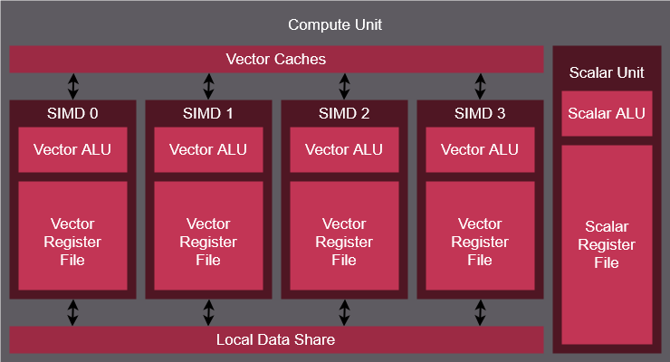
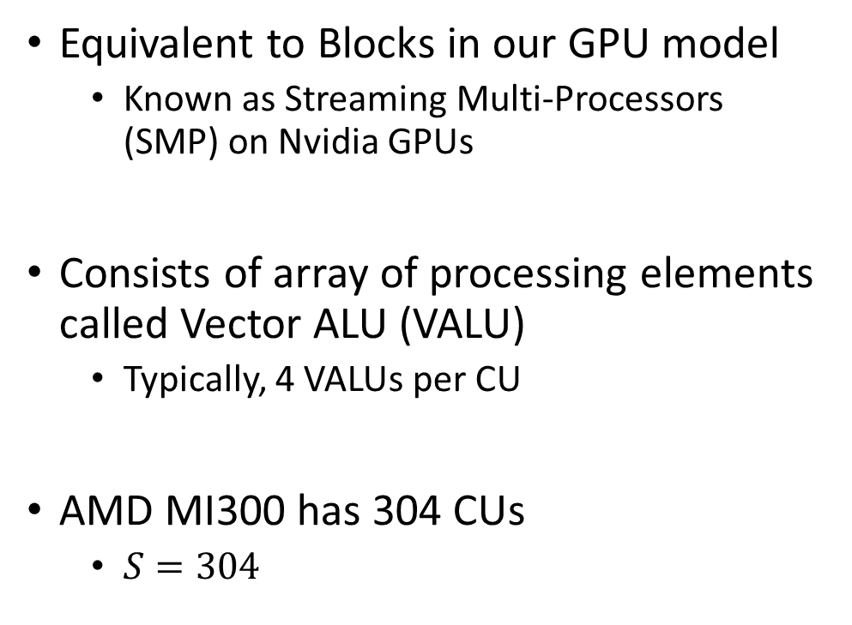
Compute Unit
Equivalent to Blocks in our GPU model
Known as Streaming Multi-Processors (SMP) on Nvidia GPUs
Consists of array of processing elements called Vector ALU (VALU)
Typically, 4 VALUs per CU
AMD MI300 has 304 CUs
$S=304$
=
C

Slide 21
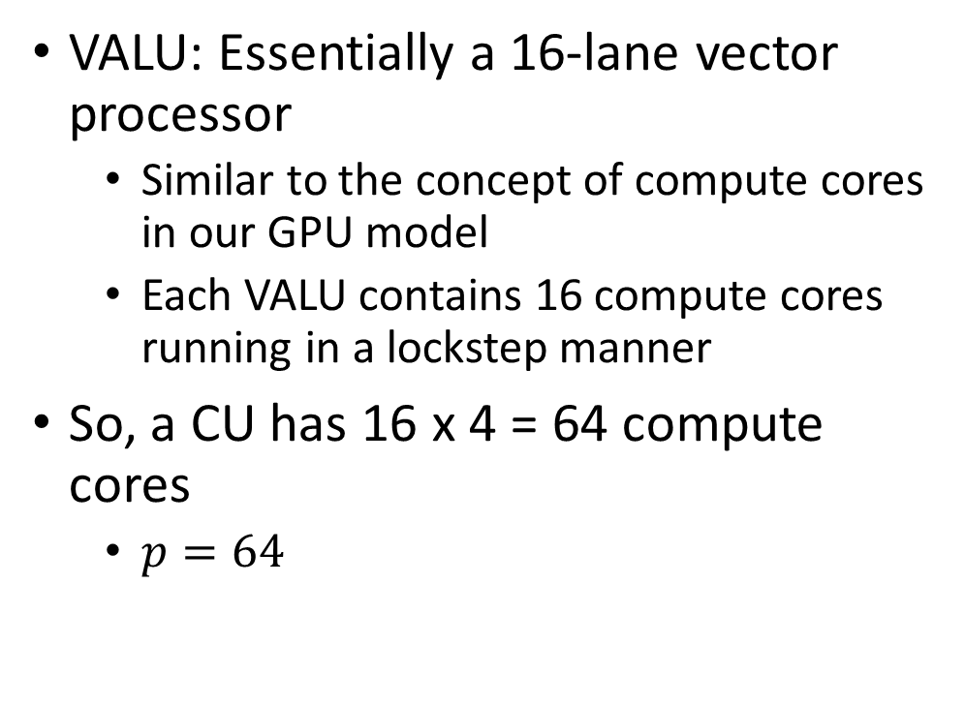
Compute Unit
VALU: Essentially a 16-lane vector processor
Similar to the concept of compute cores in our GPU model
Each VALU contains 16 compute cores running in a lockstep manner
So, a CU has 16 x 4 = 64 compute cores
$p=64$
=
C

Slide 22
Compute Unit
Each VALU consists of Vector Register File
64KB - 256 total registers – each register is 64 4-byte-wide entries
Private to each compute core
Each CU consists of Local Data Share (LDS)
64 KB – Shared Cache in our GPU model
Can be used to share data between all threads mapped to the same CU
A smaller Vector Cache/L1 Cache is also available, not user controllable
=
C

Slide 23
Compute Unit
Matrix Cores – Special cores to perform matrix multiplications
Similar to Tensor Cores in Nvidia GPUs
Programmed using WMMA instructions
We will not cover, but if you are interested, reach out to me
=
C

Slide 24
Outline
Introduction to HIP
AMD GPU Hardware Model
AMD Programming Model
Implementation Basics

Slide 25
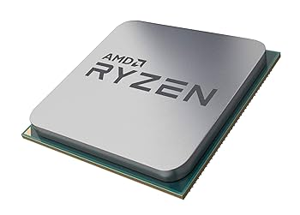
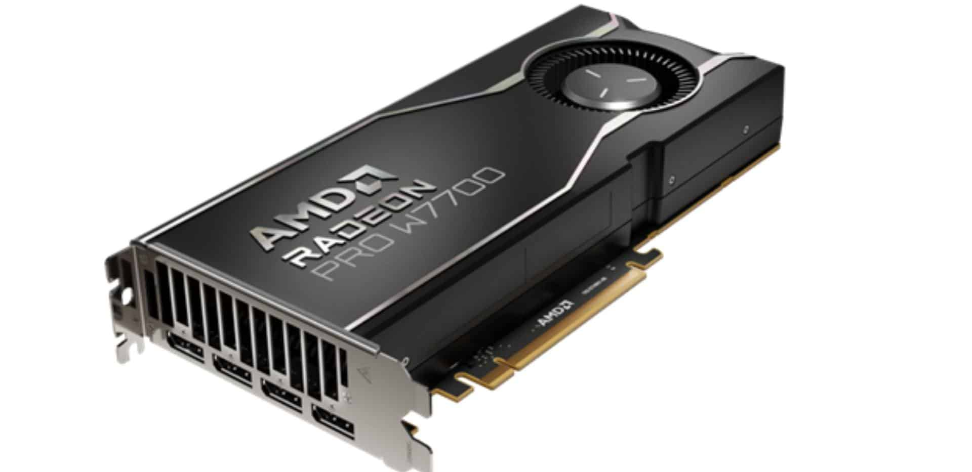
AMD GPU Programming Concepts
The Host (CPU)
Host code runs here
Usual C++ syntax and features
Can be used to create device buffers, move data between host and device, and launch device code.
The Device (GPU)
Device code runs here
C-like syntax
Device codes are launched via “kernels”
Instructions from the Host are enqueued into “streams”

Slide 26
AMD GPU Programming Concepts - Grid
Piece of Code that runs on the GPU is called a kernel
Each kernel is executed on a grid
Our algorithms get mapped onto the grid
Grid can be 1D, 2D, or 3D
More of a programming construct, hardware simply converts into 1D grid for execution
Recall: We used 1D block for MV, 2D block for blocked matrix multiplication

Slide 27
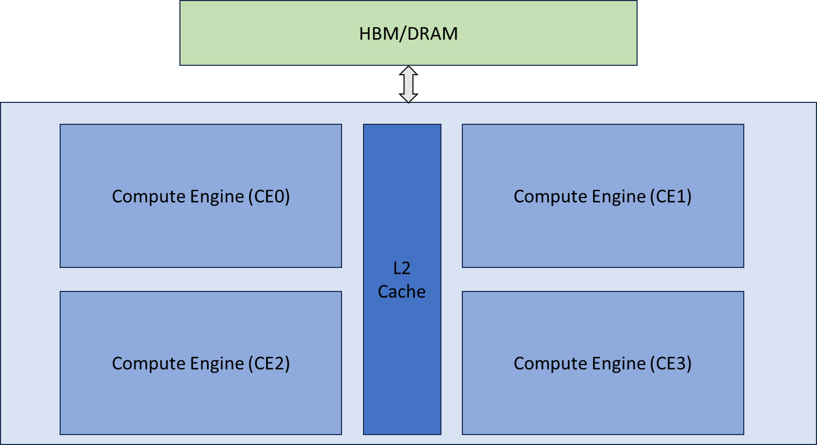
AMD GPU Programming Concepts - Grid
Grid

Slide 28
AMD GPU Programming Concepts - Block
Grid is partitioned into equal sized blocks
3D grid partitioned into 3D blocks
2D grid partitioned into 2D blocks
1D grid partitioned into 1D blocks
Each block gets mapped to a CU

Slide 29
AMD GPU Programming Concepts - Block
Grid
Block
Block
Block
Block

Slide 30
AMD GPU Programming Concepts - Threads
Blocks are composed of threads
Threads do the work and implement the data parallel algorithm
Threads are grouped together into warps that get scheduled on the VALUs.
Warps do not appear in the programming model
Although useful when deciding the number of blocks per threads
Threads in a block have access to a shared memory – Local Data Share

Slide 31
AMD GPU Programming Concepts - Threads
Grid
Block
Block
Block
Block
Warps and Threads

Slide 32
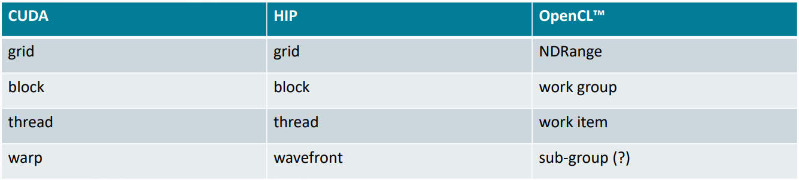
AMD GPU Programming Concepts

Slide 33
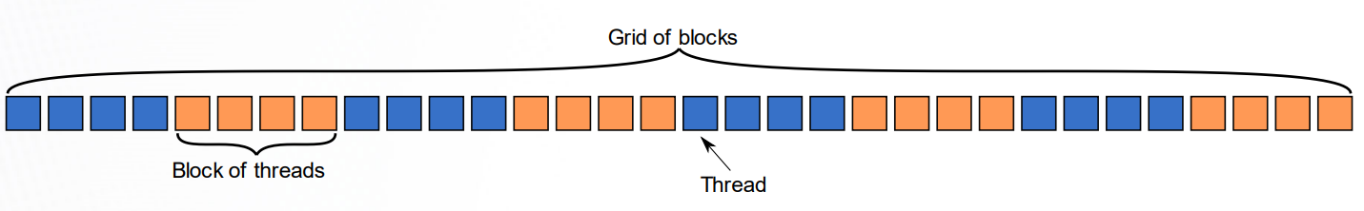
AMD GPU Programming Concepts – 1D Blocks
Each thread has access to the following configuration variables
Block ID of the block they belong to: blockIdx.x
Thread ID within their block: threadIDx.x
Dimension of the blocks in the kernel: blockDim.x
Number of blocks in grid: gridDim.x

Slide 34
AMD GPU Programming Concepts – 1D Blocks
gridDim - 8
blockDim - 4

Slide 35
AMD GPU Programming Concepts – 1D Blocks
gridDim - 8
blockDim - 4

Slide 36
AMD GPU Programming Concepts – 1D Blocks
threadIdx.x = 0
gridDim - 8
blockDim - 4

Slide 37
AMD GPU Programming Concepts – 1D Blocks
threadIdx.x = 1
gridDim - 8
blockDim - 4

Slide 38
AMD GPU Programming Concepts – 1D Blocks
threadIdx.x = 2
gridDim - 8
blockDim - 4

Slide 39
AMD GPU Programming Concepts – 1D Blocks
threadIdx.x = 3
gridDim - 8
blockDim - 4

Slide 40
AMD GPU Programming Concepts – 1D Blocks
blockIdx.x = 0
gridDim - 8
blockDim - 4

Slide 41
AMD GPU Programming Concepts – 1D Blocks
blockIdx.x = 1
gridDim - 8
blockDim - 4

Slide 42
AMD GPU Programming Concepts – 1D Blocks
blockIdx.x = 7
gridDim - 8
blockDim - 4

Slide 43
AMD GPU Programming Concepts – 1D Blocks
What is the ID of this thread?
Within the block: ??
Globally: ??
gridDim - 8
blockDim - 4

Slide 44
AMD GPU Programming Concepts – 1D Blocks
What is the ID of this thread?
Within the block: 1
Globally: 4*4 + 1 = 17
gridDim - 8
blockDim - 4

Slide 45

AMD GPU Programming Concepts – 2D Blocks
The Grid: blocks of threads in 2D
Each color is a block of threads
Each small square is a thread
The concept is the same in 1D and 2D
In 2D each block and thread now has a two-dimensional index
Threads in grid have access to:
Their respective block IDs: blockIdx.x, blockIdx.y
Their respective thread IDs in a block: threadIdx.x, threadIdx.y
Block Dimensions are: blockDim.x, blockDim.y
Grid Dimensions are: gridDim.x, gridDim.y

Slide 46
AMD GPU Programming Concepts
How do we program a GPU?
Similar to our GPU Model
Think data parallel: Same instruction, different data. Data determined by thread’s ID
Each block has access to a shared memory, use that to avoid global memory traffic

Slide 47
Outline
Introduction to AMD’s GPU Programming Stack
AMD GPU Hardware Model
AMD Programming Model
Implementation Basics

Slide 48
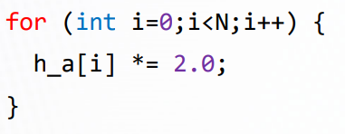
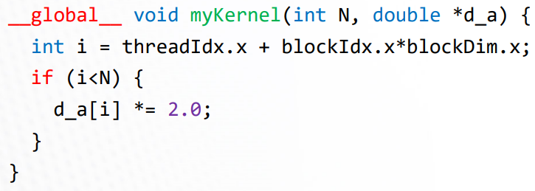
Creating a Kernel Function
A device function that will be launched from the host program is called a kernel and is declared with the __global__ attribute
Kernels should be declared void
All pointers passed to kernels must point to memory on the device
All threads execute the kernel’s body “simultaneously”
Each thread uses its unique thread and block IDs to compute a global ID
There could be more than N threads in the grid
A simple loop
Can be translated into GPU kernel

Slide 49
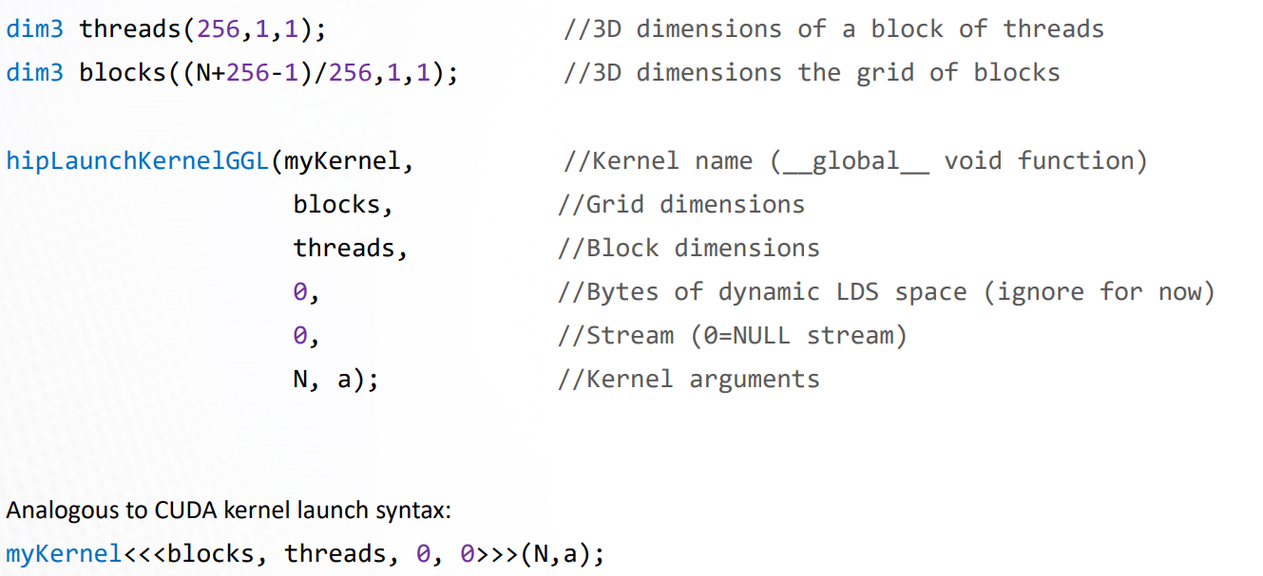
Launching a Kernel from Host CPU

Slide 50
Things to Note
Blocks get scheduled on the CUs
Note: number of blocks can be greater than the number of available CUs on the GPU
All threads in a block execute on the same CU
Threads in a block share LDS memory and L1 cache
Threads in a block are executed in 64-wide chunks called “wavefronts”
A good practice is to make the block size a multiple of 64 and have several wavefronts(e.g. 256 threads)

Slide 51
How do we decide Number of Threads?
Total number of threads = number of blocks x number of threads per blocks
dim3 blocks((N+256-1)/256, 1, 1)
dim3 threads(256, 1, 1)
It is good to have threads as a multiple of 64 (warp size)
Blocks can be determined by how much parallelism makes sense for a problem
In the case above, there is no point having more threads than the number of elements
Number of threads/blocks cannot be more than the maximum that can be offered by the hardware
More threads may also have more scheduling overheads, while offering more parallelism – sweet spot can be determined by trail and error

Slide 52
Memory Management
GPU application typically will require memory allocation at:
Host Memory: memory allocated in CPU’s RAM
Device Memory: memory allocated in GPU’s HBM/DRAM
Host memory allocated using malloc
Host instructs device to allocate memory in its Global memory using hipMalloc

Slide 53
Memory Management
int main () {
int N = 1000;
size_t Nbytes = N*sizeof(double);
double *h_a = (double*) malloc(Nbytes); //Host memory
double *d_a = NULL;
hipMalloc(&d_a, Nbytes); //Allocate Nbytes in the device memory
…
free(h_a); //Free Host memory
hipFree(d_a); //Free Device memory
}

Slide 54
Memory Management
Data will need to be copied from host to device
Model weights
Dataset
And, results need to be transferred back from device to host
Trained model weights
Prediction results
You can also copy data within the device

Slide 55
Memory Management
//copy data from host to device
hipMemcpy(d_a, h_a, Nbytes, hipMemcpyHostToDevice);
//copy data from device to host
hipMemcpy(h_a, d_a, Nbytes, hipMemcpyDeviceToHost);
//copy data from one device buffer to another
hipMemcpy(d_b, d_a, Nbytes, hipMemcpyDeviceToDevice);

Slide 56
Memory Management
//copy data from host to device
hipMemcpy(d_a, h_a, Nbytes, hipMemcpyHostToDevice);
//copy data from device to host
hipMemcpy(h_a, d_a, Nbytes, hipMemcpyDeviceToHost);
//copy data from one device buffer to another
hipMemcpy(d_b, d_a, Nbytes, hipMemcpyDeviceToDevice);
Notice which buffer is source and which buffer is destination

Slide 57
Memory Management
//copy data from host to device
hipMemcpy(d_a, h_a, Nbytes, hipMemcpyHostToDevice);
//copy data from device to host
hipMemcpy(h_a, d_a, Nbytes, hipMemcpyDeviceToHost);
//copy data from one device buffer to another
hipMemcpy(d_b, d_a, Nbytes, hipMemcpyDeviceToDevice);
Notice the flags that decide the direction of transfer

Slide 58
Error Checking
Most HIP API functions return error codes of type hipError_t
hipError_t == hipSuccess implies the API call was successful
hipGetErrorString(status) outputs the error string
You can use the following macro in your code for ease of programming:
#define HIP_CHECK(command) { \
hipError_t status = command; \
if(status!=hipSuccess) { \
std::cerr<< “Error: HIP reports ” << hipGetErrorString(status) << std::endl; \
std::abort(); } }

Slide 59
Putting it all Together
#include “hip/hip_runtime.h”
int main() {
int N = 1000;
size_t Nbytes= N*sizeof(double);
double *h_a= (double*) malloc(Nbytes); //host memory
double *d_a= NULL;
HIP_CHECK(hipMalloc(&d_a, Nbytes));
…
HIP_CHECK(hipMemcpy(d_a, h_a, Nbytes, hipMemcpyHostToDevice)); //copy data to device
HIP_CHECK(hipLaunchKernelGGL(myKernel, dim3((N+256-1)/256,1,1), dim3(256,1,1), 0, 0, N, d_a)); //Launch kernel
HIP_CHECK(hipMemcpy(h_a, d_a, Nbytes, hipMemcpyDeviceToHost)); //copy results back to host
…
free(h_a); //free host memory
HIP_CHECK(hipFree(d_a)); //free device memory
}
__global__ void myKernel(int N, double *d_a) {
int i= threadIdx.x+ blockIdx.x*blockDim.x;
if(i<N) {
d_a[i] *= 2.0;
}
}
*There is an error in this code, will discuss in a few slides

Slide 60
Querying Device Properties
You can query device properties to find out information such as total global memory, shared memory, limits on maximum number of blocks per grids, or threads per block, number of CUs, warpsize, etc.
Helpful in keep our code more performance-portable
Example: Number of threads per block should be multiple of warpsize

Slide 61
Querying Device Properties
hipDevice Prop_tprops;
hipGetDeviceProperties(&props, deviceID);
Look at https://github.com/ROCm/hip/blob/develop/include/hip/hip_runtime_api.h to find the information on the properties
Ungraded HW Assignment: Can you find out how to get the properties listed in the previous slide?

Slide 62
Blocking vs Non-Blocking APIs
In CPUs, function calls are usually Blocking
retval = func();
retval will be set only after func finishes the execution
GPU related function calls can be blocking or non-blocking
Non-blocking: We do not wait for the function execution to finish, but proceed in parallel

Slide 63
Blocking vs Non-Blocking APIs
The kernel launch function, hipLaunchKernelGGL, is non-blocking for the host.
After sending instructions/data, the host continues immediately while the device executes the kernel
You can do some different work (on CPU) during this time.
hipMemcpy is blocking.
Host code will proceed to the next line only after the memory transfer is complete
Non blocking version of memory transfers is hipMemcpyAsync
hipMemcpyAsync(d_a, h_a, Nbytes, hipMemcpyHostToDevice, stream);

Slide 64
Blocking vs Non-Blocking APIs
Sometimes we need to be sure that a non-blocking call has finished execution.
hipDeviceSynchronize()
Host waits until all pending asynchronous calls on the device finish execution

Slide 65
Putting it all Together
#include “hip/hip_runtime.h”
int main() {
int N = 1000;
size_t Nbytes= N*sizeof(double);
double *h_a= (double*) malloc(Nbytes); //host memory
double *d_a= NULL;
HIP_CHECK(hipMalloc(&d_a, Nbytes));
…
HIP_CHECK(hipMemcpy(d_a, h_a, Nbytes, hipMemcpyHostToDevice)); //copy data to device
HIP_CHECK(hipLaunchKernelGGL(myKernel, dim3((N+256-1)/256,1,1), dim3(256,1,1), 0, 0, N, d_a)); //Launch kernel
HIP_CHECK(hipMemcpy(h_a, d_a, Nbytes, hipMemcpyDeviceToHost)); //copy results back to host
…
free(h_a); //free host memory
HIP_CHECK(hipFree(d_a)); //free device memory
}
__global__ void myKernel(int N, double *d_a) {
int i= threadIdx.x+ blockIdx.x*blockDim.x;
if(i<N) {
d_a[i] *= 2.0;
}
}
Can you tell me what the error is now?

Slide 66
Putting it all Together
#include “hip/hip_runtime.h”
int main() {
int N = 1000;
size_t Nbytes= N*sizeof(double);
double *h_a= (double*) malloc(Nbytes); //host memory
double *d_a= NULL;
HIP_CHECK(hipMalloc(&d_a, Nbytes));
…
HIP_CHECK(hipMemcpy(d_a, h_a, Nbytes, hipMemcpyHostToDevice)); //copy data to device
HIP_CHECK(hipLaunchKernelGGL(myKernel, dim3((N+256-1)/256,1,1), dim3(256,1,1), 0, 0, N, d_a)); //Launch kernel
HIP_CHECK(hipMemcpy(h_a, d_a, Nbytes, hipMemcpyDeviceToHost)); //copy results back to host
…
free(h_a); //free host memory
HIP_CHECK(hipFree(d_a)); //free device memory
}
__global__ void myKernel(int N, double *d_a) {
int i= threadIdx.x+ blockIdx.x*blockDim.x;
if(i<N) {
d_a[i] *= 2.0;
}
}
Can you tell me what the error is now? We are not waiting for the kernel to finish execution before copying back the data

Slide 67
Putting it all Together
#include “hip/hip_runtime.h”
int main() {
int N = 1000;
size_t Nbytes= N*sizeof(double);
double *h_a= (double*) malloc(Nbytes); //host memory
double *d_a= NULL;
HIP_CHECK(hipMalloc(&d_a, Nbytes));
…
HIP_CHECK(hipMemcpy(d_a, h_a, Nbytes, hipMemcpyHostToDevice)); //copy data to device
HIP_CHECK(hipLaunchKernelGGL(myKernel, dim3((N+256-1)/256,1,1), dim3(256,1,1), 0, 0, N, d_a)); //Launch kernel
HIP_CHECK(hipDeviceSynchronize())
HIP_CHECK(hipMemcpy(h_a, d_a, Nbytes, hipMemcpyDeviceToHost)); //copy results back to host
…
free(h_a); //free host memory
HIP_CHECK(hipFree(d_a)); //free device memory
}
__global__ void myKernel(int N, double *d_a) {
int i= threadIdx.x+ blockIdx.x*blockDim.x;
if(i<N) {
d_a[i] *= 2.0;
}
}
The host code will wait on this line till the launched kernel finishes execution.

Slide 68
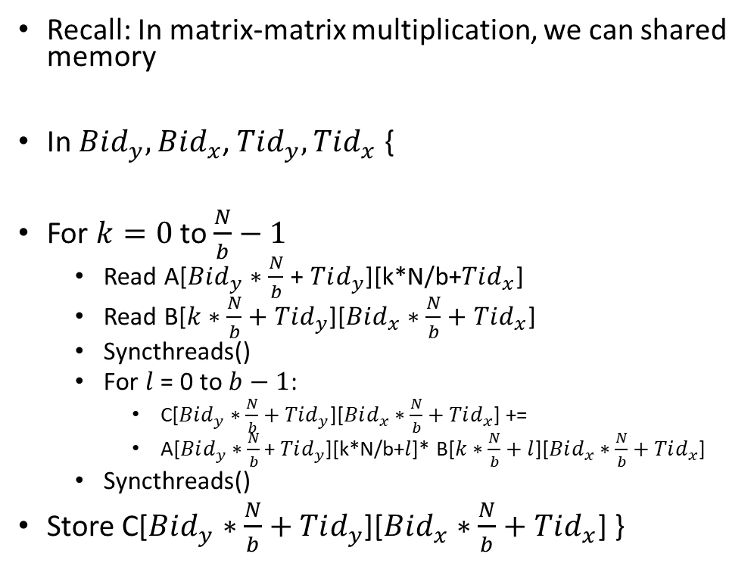
Shared Memory and Thread Synchronization
Recall: In matrix-matrix multiplication, we can shared memory
In $Bid_{y}, Bid_{x}$, $Tid_{y}, Tid_{x}$ {
For $k=0$ to $\frac{N}{b}−1$
Read A[$Bid_{y}∗\frac{N}{b}$ + $Tid_{y}$][k*N/b+$Tid_{x}$]
Read B[$k∗\frac{N}{b}+Tid_{y}$][$Bid_{x}∗\frac{N}{b}+Tid_{x}$]
Syncthreads()
For $l$ = 0 to $b−1$:
C[$Bid_{y}∗\frac{N}{b}+Tid_{y}$][$Bid_{x}∗\frac{N}{b}+Tid_{x}$] +=
A[$Bid_{y}∗\frac{N}{b}$ + $Tid_{y}$][k*N/b+$l$]* B[$k∗\frac{N}{b}+l$][$Bid_{x}∗\frac{N}{b}+Tid_{x}$]
Syncthreads()
Store C[$Bid_{y}∗\frac{N}{b}+Tid_{y}$][$Bid_{x}∗\frac{N}{b}+Tid_{x}$] }
__global__ void blockMM(double *A, double *B, …)
{
//Define a shared memory array
__shared__ double A_shared[b][N];
__shared__ double B_shared[N][b];
for (k = 0; k < N/b; k++) {
A_shared[…][…] = A[…][…];
B_shared[…][…] = B[…][…];
__syncthreads();
}
}

Slide 69
Shared Memory and Thread Synchronization
Recall: In matrix-matrix multiplication, we can shared memory
In $Bid_{y}, Bid_{x}$, $Tid_{y}, Tid_{x}$ {
For $k=0$ to $\frac{N}{b}−1$
Read A[$Bid_{y}∗\frac{N}{b}$ + $Tid_{y}$][k*N/b+$Tid_{x}$]
Read B[$k∗\frac{N}{b}+Tid_{y}$][$Bid_{x}∗\frac{N}{b}+Tid_{x}$]
Syncthreads()
For $l$ = 0 to $b−1$:
C[$Bid_{y}∗\frac{N}{b}+Tid_{y}$][$Bid_{x}∗\frac{N}{b}+Tid_{x}$] +=
A[$Bid_{y}∗\frac{N}{b}$ + $Tid_{y}$][k*N/b+$l$]* B[$k∗\frac{N}{b}+l$][$Bid_{x}∗\frac{N}{b}+Tid_{x}$]
Syncthreads()
Store C[$Bid_{y}∗\frac{N}{b}+Tid_{y}$][$Bid_{x}∗\frac{N}{b}+Tid_{x}$] }
__global__ void blockMM(double *A, double *B, …)
{
//Define a shared memory array
__shared__ double A_shared[b][N];
__shared__ double B_shared[N][b];
for (k = 0; k < N/b; k++) {
A_shared[…][…] = A[…][…];
B_shared[…][…] = B[…][…];
__syncthreads();
}
}
Variable needs to be defined using __shared__ keyword

Slide 70
Shared Memory and Thread Synchronization
Recall: In matrix-matrix multiplication, we can shared memory
In $Bid_{y}, Bid_{x}$, $Tid_{y}, Tid_{x}$ {
For $k=0$ to $\frac{N}{b}−1$
Read A[$Bid_{y}∗\frac{N}{b}$ + $Tid_{y}$][k*N/b+$Tid_{x}$]
Read B[$k∗\frac{N}{b}+Tid_{y}$][$Bid_{x}∗\frac{N}{b}+Tid_{x}$]
Syncthreads()
For $l$ = 0 to $b−1$:
C[$Bid_{y}∗\frac{N}{b}+Tid_{y}$][$Bid_{x}∗\frac{N}{b}+Tid_{x}$] +=
A[$Bid_{y}∗\frac{N}{b}$ + $Tid_{y}$][k*N/b+$l$]* B[$k∗\frac{N}{b}+l$][$Bid_{x}∗\frac{N}{b}+Tid_{x}$]
Syncthreads()
Store C[$Bid_{y}∗\frac{N}{b}+Tid_{y}$][$Bid_{x}∗\frac{N}{b}+Tid_{x}$] }
__global__ void blockMM(double *A, double *B, …)
{
//Define a shared memory array
__shared__ double A_shared[b][N];
__shared__ double B_shared[N][b];
for (k = 0; k < N/b; k++) {
A_shared[…][…] = A[…][…];
B_shared[…][…] = B[…][…];
__syncthreads();
}
}
Can you think about these indices, you will need it for your PA 1

Slide 71
Shared Memory and Thread Synchronization
Recall: In matrix-matrix multiplication, we can shared memory
In $Bid_{y}, Bid_{x}$, $Tid_{y}, Tid_{x}$ {
For $k=0$ to $\frac{N}{b}−1$
Read A[$Bid_{y}∗\frac{N}{b}$ + $Tid_{y}$][k*N/b+$Tid_{x}$]
Read B[$k∗\frac{N}{b}+Tid_{y}$][$Bid_{x}∗\frac{N}{b}+Tid_{x}$]
Syncthreads()
For $l$ = 0 to $b−1$:
C[$Bid_{y}∗\frac{N}{b}+Tid_{y}$][$Bid_{x}∗\frac{N}{b}+Tid_{x}$] +=
A[$Bid_{y}∗\frac{N}{b}$ + $Tid_{y}$][k*N/b+$l$]* B[$k∗\frac{N}{b}+l$][$Bid_{x}∗\frac{N}{b}+Tid_{x}$]
Syncthreads()
Store C[$Bid_{y}∗\frac{N}{b}+Tid_{y}$][$Bid_{x}∗\frac{N}{b}+Tid_{x}$] }
__global__ void blockMM(double *A, double *B, …)
{
//Define a shared memory array
__shared__ double A_shared[b][N];
__shared__ double B_shared[N][b];
for (k = 0; k < N/b; k++) {
A_shared[…][…] = A[…][…];
B_shared[…][…] = B[…][…];
__syncthreads();
}
}
This ensures that all threads in the block have copied the data they own

Slide 72
Additional Concepts
Concepts covered till now will enable you to write GPU accelerated programs
To further improve performance, please checkout the following concepts
Streams: https://rocmdocs.amd.com/projects/HIP/en/latest/how-to/hip_runtime_api/asynchronous.html
Enable concurrent kernel execution on GPU leading to improved resource utilization and overlapping of computation and communication
HIP Graphs: https://rocmdocs.amd.com/projects/HIP/en/latest/how-to/hip_runtime_api/hipgraph.html
A more sophisticated version of scheduling kernels than streams – Think of task graphs

Slide 73
Next Class
10/7 Lecture 13
Pytorch Lightning

Slide 74
Thank You
Questions?
Email: sanmukh.kuppannagari@case.edu

